Slide 1


AtliQ Grands Hospitality Domain
View in Power BI
SWETHA C S
DATA ANALYST
Last data refresh:
4/23/2024 10:54:03 AM UTC
Downloaded at:
4/23/2024 11:05:29 AM UTC

Slide 2
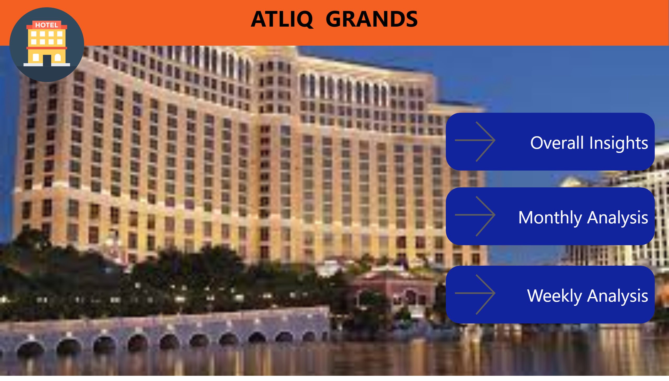
HOME
Notes:
textbox
No alt text provided
image
No alt text provided
actionButton
No alt text provided
actionButton
No alt text provided
actionButton
No alt text provided

Slide 3
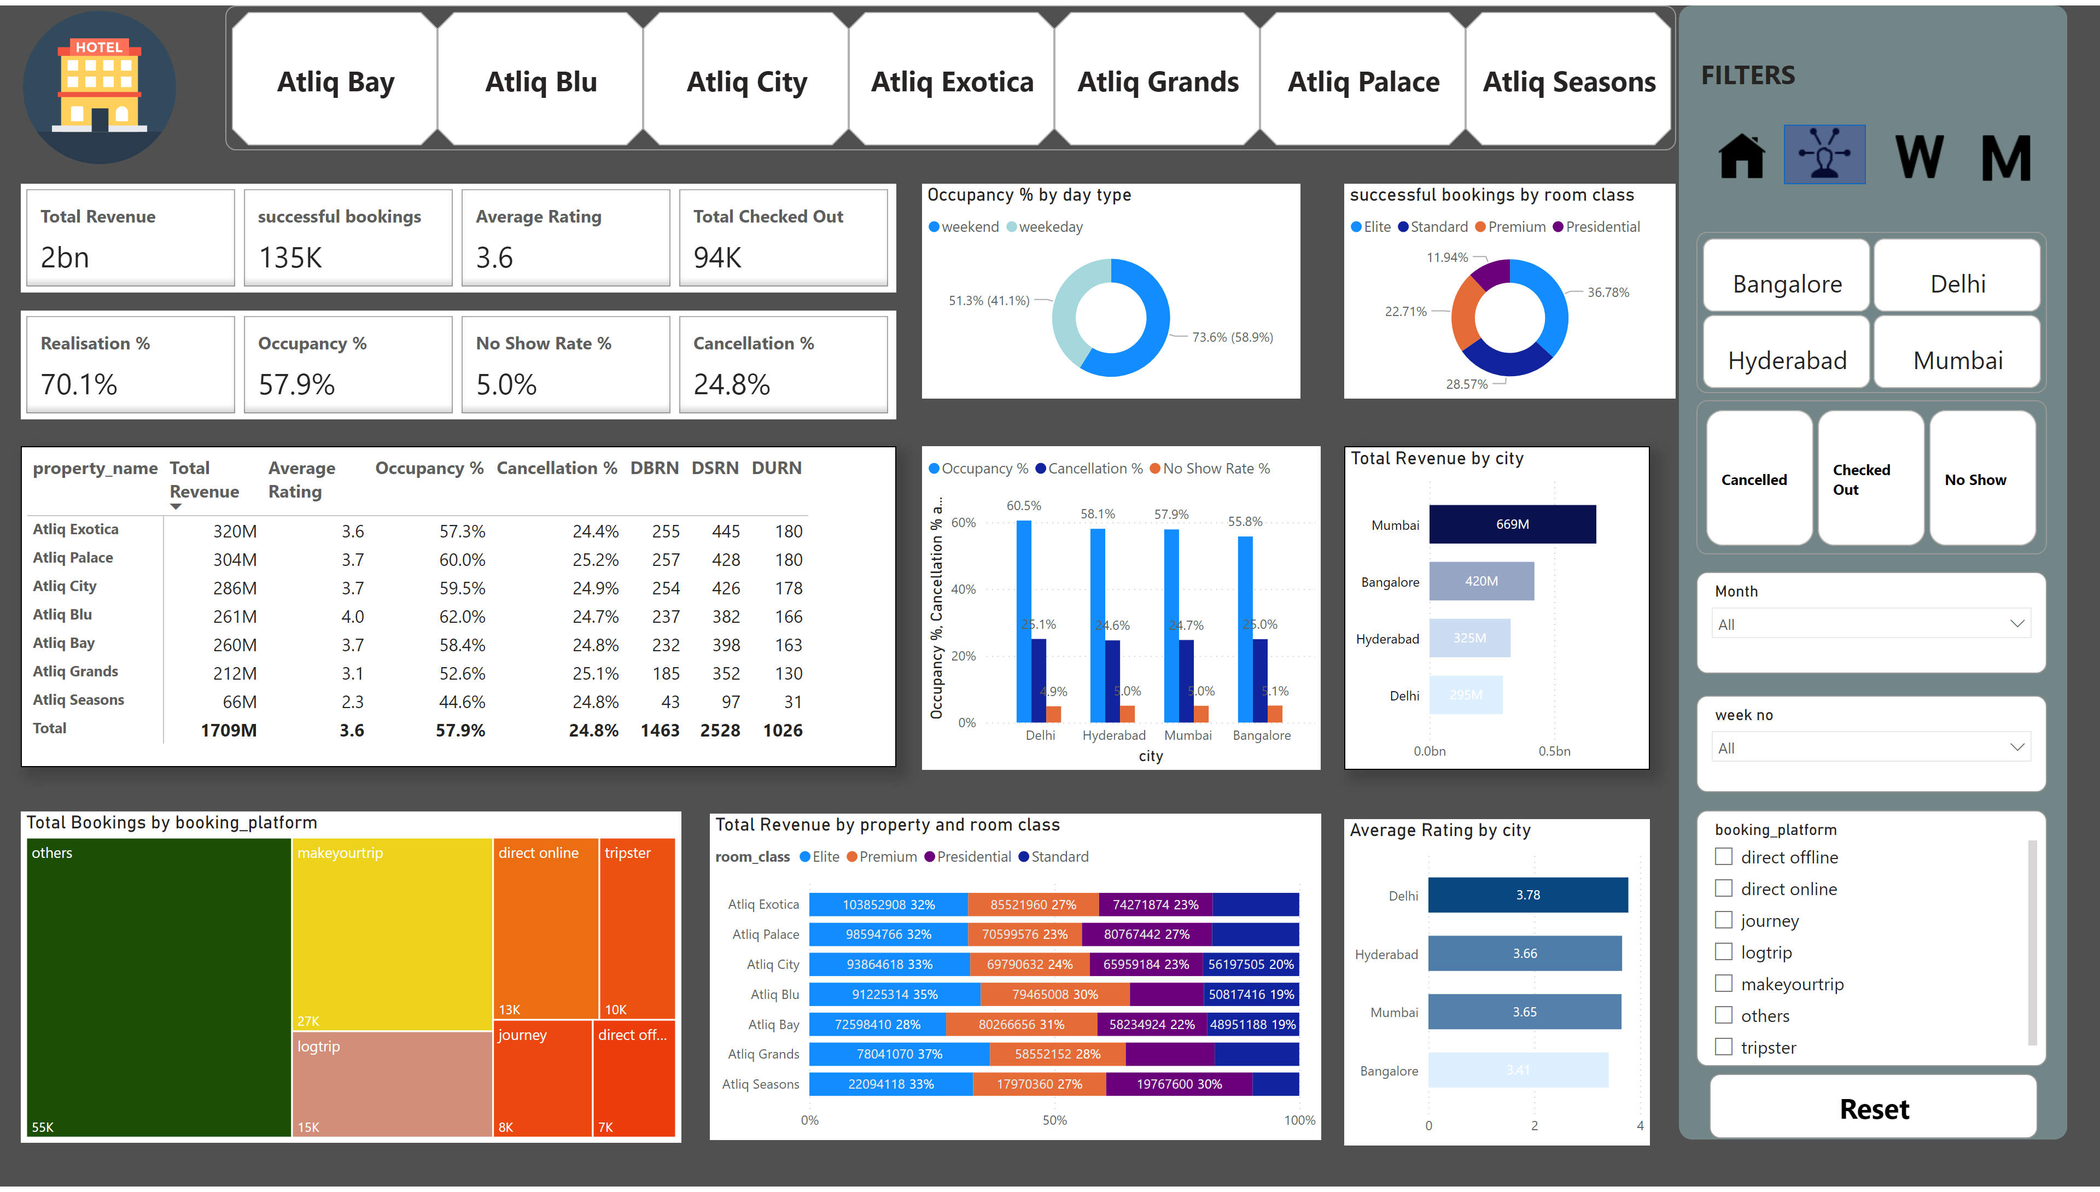
Overall Insights
Notes:
shape
No alt text provided
advancedSlicerVisual
No alt text provided
advancedSlicerVisual
No alt text provided
advancedSlicerVisual
No alt text provided
slicer
No alt text provided
slicer
No alt text provided
barChart
No alt text provided
barChart
No alt text provided
clusteredColumnChart
No alt text provided
pivotTable
No alt text provided
Occupancy % by day type
No alt text provided
treemap
No alt text provided
slicer
No alt text provided
successful bookings by room class
No alt text provided
textbox
No alt text provided
actionButton
No alt text provided
Total Revenue by property and room class
No alt text provided
cardVisual
No alt text provided
cardVisual
No alt text provided
image
No alt text provided
image
No alt text provided
image
No alt text provided
shape
No alt text provided
image
No alt text provided
image
No alt text provided

Slide 4
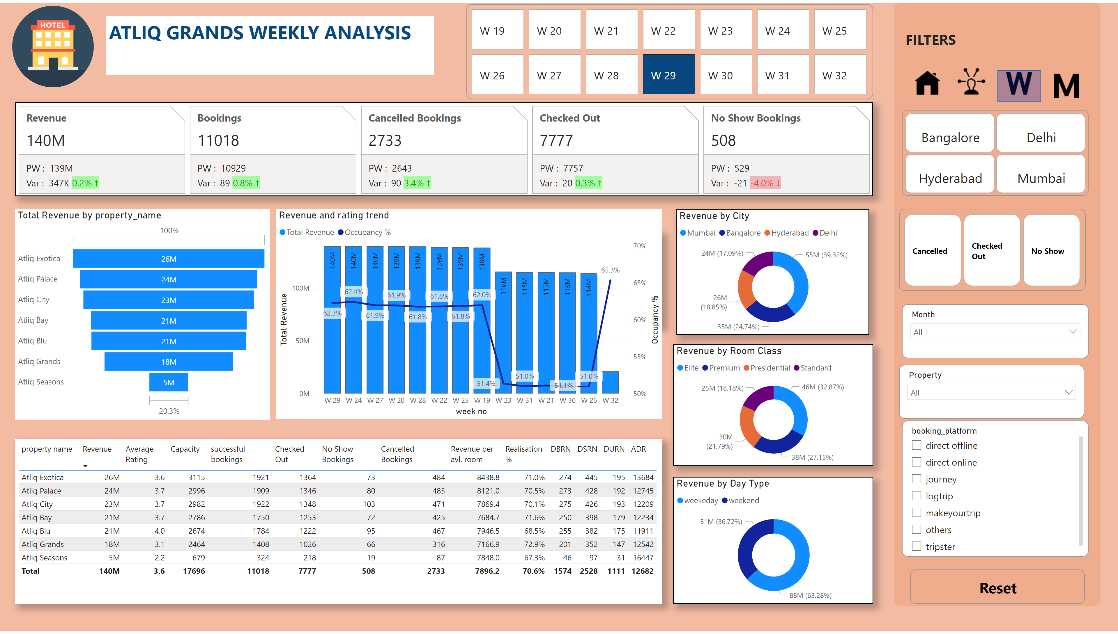
weekly analysis
Notes:
shape
No alt text provided
advancedSlicerVisual
No alt text provided
advancedSlicerVisual
No alt text provided
slicer
No alt text provided
advancedSlicerVisual
No alt text provided
slicer
No alt text provided
textbox
No alt text provided
image
No alt text provided
textbox
No alt text provided
Bookings vs Checked out
No alt text provided
Bookings vs No Show
No alt text provided
Revenue by Room Class
No alt text provided
Revenue by Day Type
No alt text provided
cardVisual
No alt text provided
slicer
No alt text provided
actionButton
No alt text provided
Revenue and rating trend
No alt text provided
tableEx
No alt text provided
funnel
No alt text provided
Revenue by City
No alt text provided
image
No alt text provided
image
No alt text provided
image
No alt text provided
shape
No alt text provided
image
No alt text provided

Slide 5
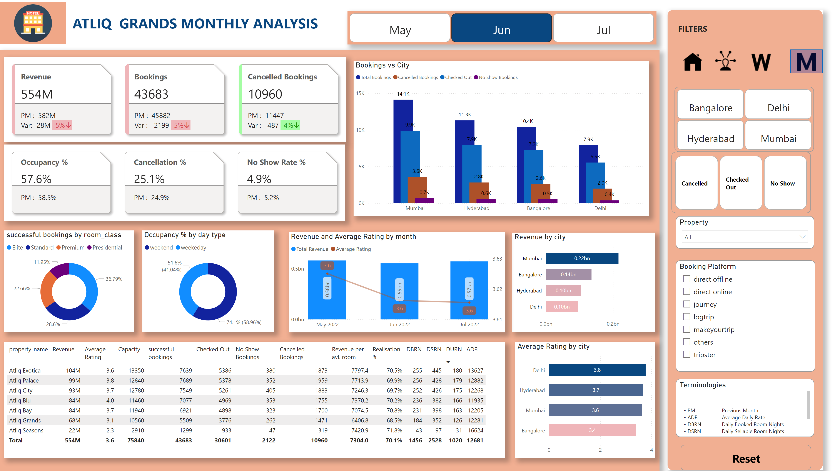
monthly analysis
Notes:
shape
No alt text provided
advancedSlicerVisual
No alt text provided
advancedSlicerVisual
No alt text provided
Booking Platform
No alt text provided
actionButton
No alt text provided
Property
No alt text provided
advancedSlicerVisual
No alt text provided
textbox
No alt text provided
image
No alt text provided
Terminologies
No alt text provided
textbox
No alt text provided
successful bookings by room_class
No alt text provided
Occupancy % by day type
No alt text provided
Revenue and Average Rating by month
No alt text provided
Revenue by city
No alt text provided
barChart
No alt text provided
tableEx
No alt text provided
bg1
No alt text provided
first card
No alt text provided
sec card
No alt text provided
Bookings vs City
No alt text provided
image
No alt text provided
image
No alt text provided
image
No alt text provided
image
No alt text provided
shape
No alt text provided

Slide 6
INSIGHTS
Mumbai is generating highest revenue of 669 M followed by Bangalore, Hyderabad and Delhi.
AtliQ Exotica property is a top performer with revenue 320M and AtliQ Seasons is the least with revenue 66M
AtliQ Blu shows the highest occupancy % with revenue of 261 M comes in top 4.
Delhi has the highest average rating of 3.78
The occupancy % of weekend is always more than weekday.
Elite room class brings highest revenue contributing nearly 37% to total revenue.
Week 29 shows the highest revenue generation of around 139 M.
May month shows highest revenue generation followed by July and June.
Week 32 shows the least revenue generation but the data available is only for one day since it’s the last day of July so week 26 is the lowest with revenue of 114 M

Slide 7
Thank You

